Slide 1


Slide 2



Furniture Management System
An online furniture shop that allows users to check for various furniture available at the online store and purchase online.
The user may browse through these products as per categories
The online furniture shopping project brings an entirefurniture shop online and makes it easy for both buyer and seller to make furniture deals.
Once the user makes a successful transaction he gets acopy of the shopping receipt as a PDF.

Slide 3
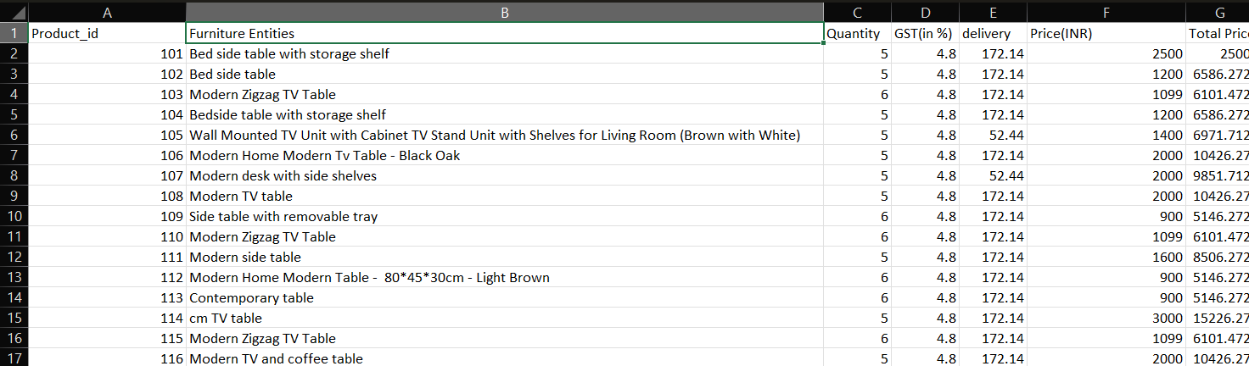
Furniture DataSet

Slide 4
DATASET EXPLAINATION
The image shows a dataset of various furniture items listed in a spreadsheet. Each row represents a different furniture product, detailing its unique ID, description, quantity available, GST rate, delivery charges, base price, and total price. This dataset is relevant for inventory management, pricing analysis, and sales reporting in a furniture business.
Additionally, this dataset can be utilized for market trend analysis and strategic planning, allowing businesses to make informed decisions about inventory restocking, pricing strategies, and promotional offers. 📊✨

Slide 5
Source Code for Furniture Management System
import pandas as pd
from reportlab.lib.pagesizes import letter
from reportlab.pdfgen import canvas
from reportlab.lib import colors
from datetime import datetime
import os
import random
def wrap_text(c, text, width, font_name="Helvetica", font_size=10):
"""Wrap text to fit within the specified width (in points)."""
c.setFont(font_name, font_size)
lines = []
line = ""
for word in text.split():
if c.stringWidth(line + word, font_name, font_size) < width:
line += " " + word
else:
lines.append(line)
line = word
lines.append(line) # Add the last line
return lines

Slide 6
def initialize_bill_number_file():
bill_file = "bill_number.csv"
if not os.path.exists(bill_file):
df = pd.DataFrame({'BillID': [1]})
df.to_csv(bill_file, index=False)
print(f"Bill Number file '{bill_file}' created with initial Bill ID 1.")
else:
print(f"Bill Number file '{bill_file}' already exists.")
def inventory():
inventory_file = "D:\\IKEA\\Furniture.csv"
if os.path.exists(inventory_file):
inventory_df = pd.read_csv(inventory_file)
print("\n" + "=" * 19 + " Inventory of products in stock " + "=" * 19 + "\n")
print(inventory_df.to_string(index=False)) # Prints without row indices
else:
print(f"Error: {inventory_file} not found!")
def add_data(file_path, new_data):
try:
df = pd.read_csv(file_path)
df2 = pd.DataFrame([new_data])
df = pd.concat([df, df2], ignore_index=True)
df.to_csv(file_path, index=False)
print("Data added successfully.")
except Exception as e:
print(f"Error while adding data: {e}")

Slide 7
def update_inventory(file_path, product_id, new_quantity):
try:
df = pd.read_csv(file_path)
if product_id in df['Product_id'].values:
df.loc[df['Product_id'] == product_id, 'Quantity'] = new_quantity
df.to_csv(file_path, index=False)
print("Quantity updated successfully.")
else:
print(f"Error: Product ID {product_id} not found!")
except Exception as e:
print(f"Error in updating quantity: {e}")
def bill_making():
inventory_file = "D:\\IKEA\\Furniture.csv"
bill_file = "bill_number.csv"
all_bills_file = "all_bills.csv" # Cumulative file to store all bills with incremental Bill IDs
gst_rate = 4.8
try:
df3 = pd.read_csv(inventory_file)
df4 = pd.read_csv(bill_file)
except FileNotFoundError:
print("File not found. Make sure all required files exist.")
return
# Initialize the final bill DataFrame with column structure
final_bill = pd.DataFrame(
columns=['Bill ID', 'Buyer name', 'Buyer contact', 'ProductID', 'ProductName', 'GST', 'Price', 'Quantity',
'Total'])
bill_number = df4.loc[0, 'BillID'] # Read the current Bill ID

Slide 8
# Collect buyer details
buyer_name = input("Enter buyer name: ")
buyer_contact = int(input("Enter Buyer contact number: "))
while True:
print("\nAvailable Products in inventory:")
print(df3.to_string(index=False)) # Display inventory without indices
sell_id = int(input("Enter the Product_id to sell: "))
quantity_sold = int(input("Enter the quantity sold: "))
if sell_id in df3['Product_id'].values:
stock = df3.loc[df3['Product_id'] == sell_id, 'Quantity'].values[0]
if quantity_sold <= stock:
product_details = df3.loc[df3['Product_id'] == sell_id].iloc[0]
product_price = product_details['Total Price']
gst_amount = (product_price * gst_rate) / 100
total_cost = quantity_sold * (product_price + gst_amount)
# Update inventory quantity
df3.loc[df3['Product_id'] == sell_id, 'Quantity'] -= quantity_sold
# Append the new sale to the final bill DataFrame
new_sale = {
'Bill ID': bill_number,
'Buyer name': buyer_name,
'Buyer contact': buyer_contact,
'ProductID': sell_id,
'ProductName': product_details['Furniture Entities'],
'GST': gst_amount,
'Price': product_price,
'Quantity': quantity_sold,
'Total': total_cost
}

Slide 9
final_bill = pd.concat([final_bill, pd.DataFrame([new_sale])], ignore_index=True)
print('\n----Current purchase----')
print(f"Product_id: {sell_id}")
print(f"Furniture Entities: {product_details['Furniture Entities']}")
print(f"Quantity: {quantity_sold}")
print(f"Price per unit: INR {product_price}")
print(f"GST per unit: INR {gst_amount}")
print(f"Total cost (including GST): INR {total_cost}")
purchase = input("Do you want to buy another product? (yes/no): ").lower()
if purchase != 'yes':
break
else:
print("Not enough quantity in stock.")
else:
print("Product_id not found in inventory.")
# Increment the bill number
df4.loc[0, 'BillID'] = bill_number + 1
df4.to_csv(bill_file, index=False)
# Total amount calculation
total = final_bill['Total'].sum()
print("\n" + "=" * 29 + " HHJR FURNITURE SHOP " + "=" * 29)
print("\n" + "=" * 34 + " Final Bill " + "=" * 34)
print(f"\nBill ID of Final Bill is: {bill_number}")
print(f"Buyer name: {buyer_name}")
print(f"Buyer Contact Number: {buyer_contact}")
print("\n", final_bill.to_string(index=False))
print(f"\nFinal Total: INR {total}")
# Append the current bill to the cumulative all_bills.csv file
if os.path.exists(all_bills_file):
all_bills = pd.read_csv(all_bills_file)
all_bills = pd.concat([all_bills, final_bill], ignore_index=True)
else:
all_bills = final_bill
all_bills.to_csv(all_bills_file, index=False)
print(f"Bill data appended to '{all_bills_file}' successfully.")

Slide 10
# Create a separate folder and file for this bill
output_folder = "Bill files"
bill_folder = os.path.join(output_folder, f'Bill_{bill_number}_{buyer_name}')
os.makedirs(bill_folder, exist_ok=True)
final_bill.to_csv(os.path.join(bill_folder, f"bill_{bill_number}.csv"), index=False)
print(f"Final bill saved to '{bill_folder}' successfully.")
# Generate PDF Receipt
pdf_file = os.path.join(bill_folder, f"bill_{bill_number}.pdf")
# Set page size with custom width of 1000 and random height between 600 and 1000
custom_width = 900
custom_height = random.randint(600, 900)
c = canvas.Canvas(pdf_file, pagesize=(custom_width, custom_height))
# Helper function to print header on each page
def print_header(c, custom_width, custom_height, bill_number, buyer_name, buyer_contact):
# Center the receipt header (Store Info)
header_text = "HHJR FURNITURE SHOP"
header_width = c.stringWidth(header_text, "Helvetica-Bold", 16)
header_x_position = (custom_width - header_width) / 2 # Calculate the X-position to center the text
c.setFont("Helvetica-Bold", 16)
c.drawString(header_x_position, custom_height - 50, header_text)
c.setFont("Helvetica", 12)
address_text = "Address: XYZ Street, Some City"
address_width = c.stringWidth(address_text, "Helvetica", 12)
c.drawString((custom_width - address_width) / 2, custom_height - 70, address_text)
c.drawString((custom_width - address_width) / 2, custom_height - 90, "Phone: +91 123 456 7890")
c.drawString((custom_width - address_width) / 2, custom_height - 110, "Email: contact@hhjrfurniture.com")
# Title and Bill ID
title_text = f"RECEIPT - Bill ID: {bill_number}"
title_width = c.stringWidth(title_text, "Helvetica-Bold", 14)
c.setFont("Helvetica-Bold", 14)
c.drawString((custom_width - title_width) / 2, custom_height - 130, title_text)

Slide 11
# Date
date_text = f"Date: {datetime.now().strftime('%Y-%m-%d %H:%M:%S')}"
date_width = c.stringWidth(date_text, "Helvetica", 12)
c.setFont("Helvetica", 12)
c.drawString(custom_width - 10 - date_width, custom_height - 130, date_text)
# Buyer Info
c.setFont("Helvetica-Bold", 12)
c.drawString(30, custom_height - 180, f"Buyer: {buyer_name}")
c.setFont("Helvetica", 12)
c.drawString(30, custom_height - 200, f"Contact: {buyer_contact}")
# Start the PDF content
row_height = 20
y_position = custom_height - 250
max_rows_per_page = 10 # Max rows to print per page
# Initial header print
print_header(c, custom_width, custom_height, bill_number, buyer_name, buyer_contact)
# Print the table headers
c.setFont("Helvetica-Bold", 10)
c.drawString(30, y_position, "Product ID")
c.drawString(100, y_position, "Product Name")
c.drawString(300, y_position, "Price")
c.drawString(400, y_position, "Quantity")
c.drawString(500, y_position, "GST")
c.drawString(700, y_position, "Total")
# Line separation
c.line(30, y_position - 5, 800, y_position - 5)
y_position -= row_height # Move to next row
# Loop through rows in the bill
for index, row in final_bill.iterrows():
# Check for page break: if we have reached the max rows per page, create a new page
if (index + 1) % max_rows_per_page == 0:
c.showPage() # Start a new page
print_header(c, custom_width, custom_height, bill_number, buyer_name, buyer_contact)
y_position = custom_height - 250 # Reset the position for the new page
c.setFont("Helvetica-Bold", 10)
c.drawString(30, y_position, "Product ID")
c.drawString(100, y_position, "Product Name")
c.drawString(300, y_position, "Price")
c.drawString(400, y_position, "Quantity")
c.drawString(500, y_position, "GST")
c.drawString(700, y_position, "Total")
c.line(30, y_position - 5, 800, y_position - 5)
y_position -= row_height # Move to next row

Slide 12
# Print each row of data
c.setFont("Helvetica", 10)
c.drawString(30, y_position, str(row['ProductID']))
wrapped_name = wrap_text(c, row['ProductName'], 100)
for i, line in enumerate(wrapped_name):
c.drawString(100, y_position, line)
y_position -= row_height
c.drawString(300, y_position, f"INR {row['Price']}")
c.drawString(400, y_position, str(row['Quantity']))
c.drawString(500, y_position, f"INR {row['GST']}")
c.drawString(700, y_position, f"INR {row['Total']}")
y_position -= row_height
# Total amount at the bottom
c.setFont("Helvetica-Bold", 12)
c.drawString(400, y_position - 20, f"Total: INR {total}")
# Footer message
c.setFont("Helvetica", 10)
c.drawString(30, y_position - 40, "Thank you for shopping with us!")
c.drawString(30, y_position - 60, "Visit again!")
# Save the PDF
c.save()
print(f"Receipt saved as PDF: {pdf_file}")
# Main function to run the program
if __name__ == "__main__":
initialize_bill_number_file() # Initialize bill number file
while True:
print("\nMenu:")
print("1. View Inventory")
print("2. Add Product to Inventory")
print("3. Update Inventory Quantity")
print("4. Make Bill")
print("5. Exit")
choice = input("Enter your choice: ")

Slide 13
if choice == '1':
inventory()
elif choice == '2':
new_product = {
'Product_id': int(input("Enter Product ID: ")),
'Furniture Entities': input("Enter Product Name: "),
'Total Price': float(input("Enter Product Price: ")),
'Quantity': int(input("Enter Product Quantity: "))
}
add_data("D:\\IKEA\\Furniture.csv", new_product)
elif choice == '3':
product_id = int(input("Enter Product ID to update quantity: "))
new_quantity = int(input("Enter new quantity: "))
update_inventory("D:\\IKEA\\Furniture.csv", product_id, new_quantity)
elif choice == '4':
bill_making()
elif choice == '5':
print("Exiting...")
break
else:
print("Invalid choice. Please try again.")

Slide 14
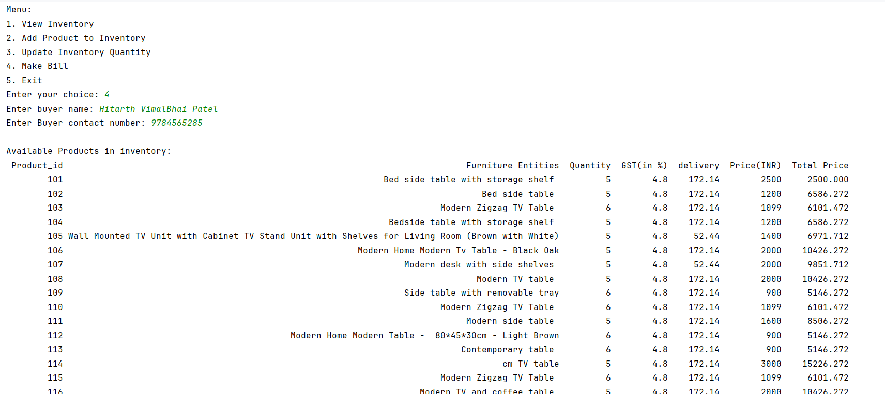
Source Code Output

Slide 15
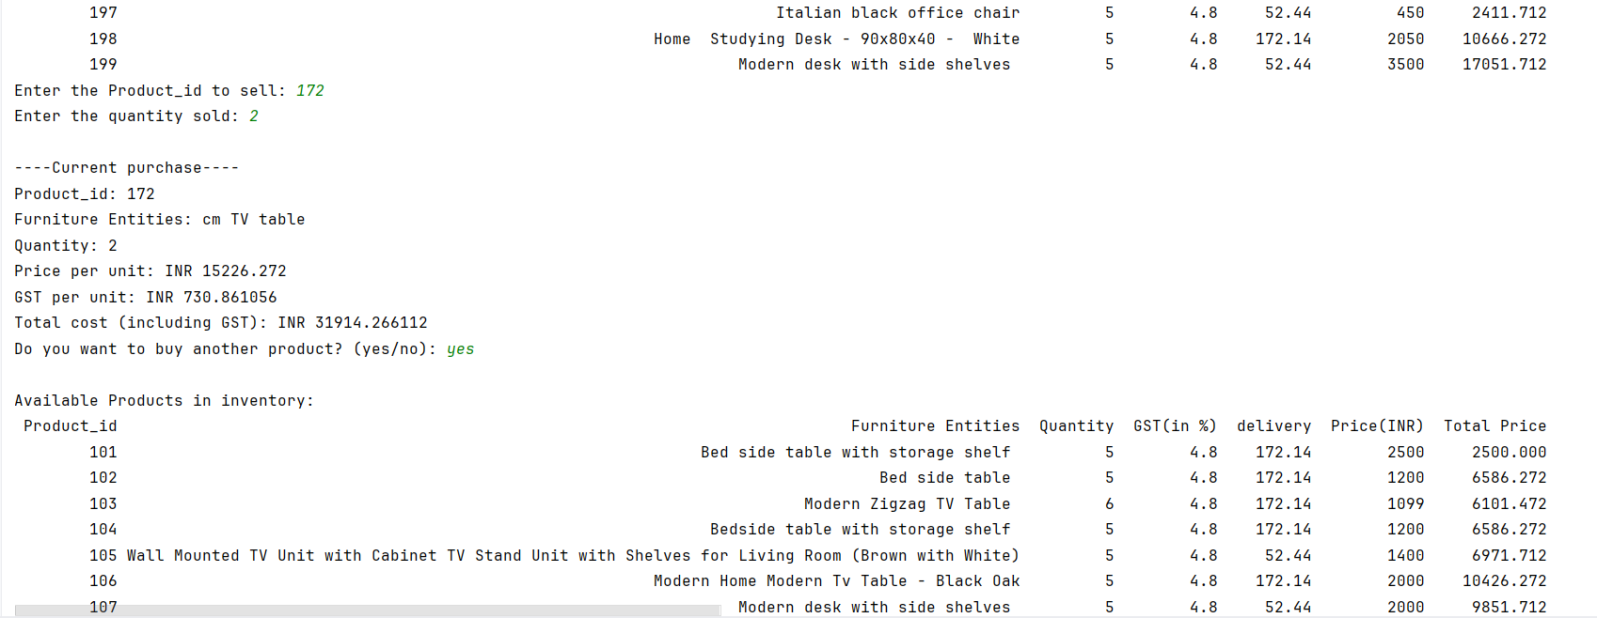
Output - cont.

Slide 16
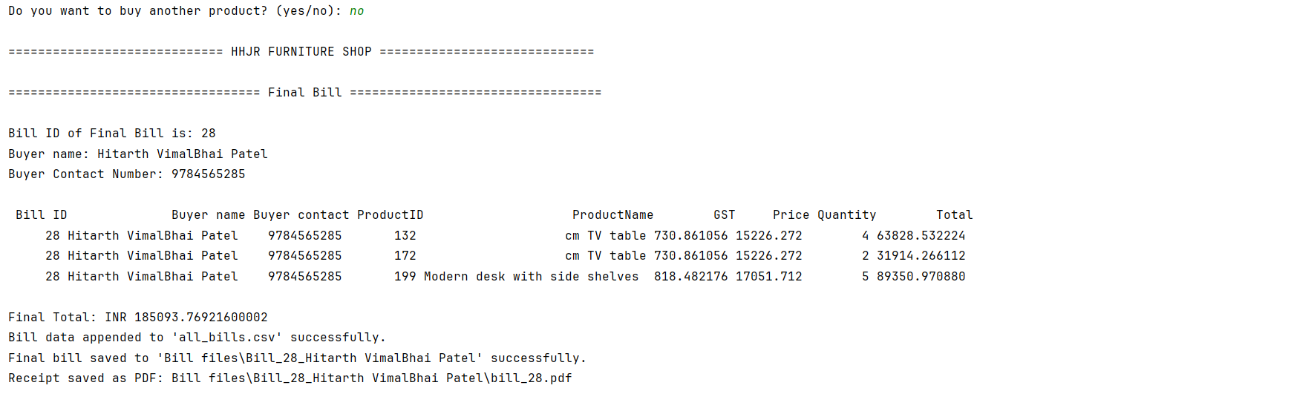

Slide 17
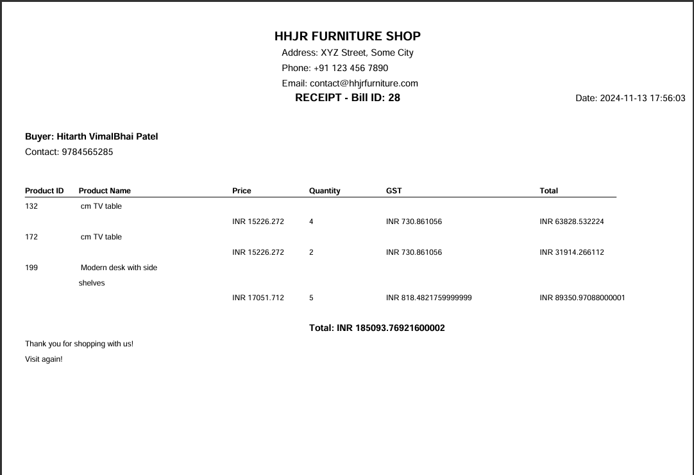
Final Bill in Receipt(in PDF)

Slide 18
Thank You
FOR SHOPPING WITH US

